Slide 1
Chapter 9: The Transformation of American Society
Presented By: Zac Angel, Jim Brendlinger, Alaina Koonst, Deana Matthews, and Meara Reed

Slide 2
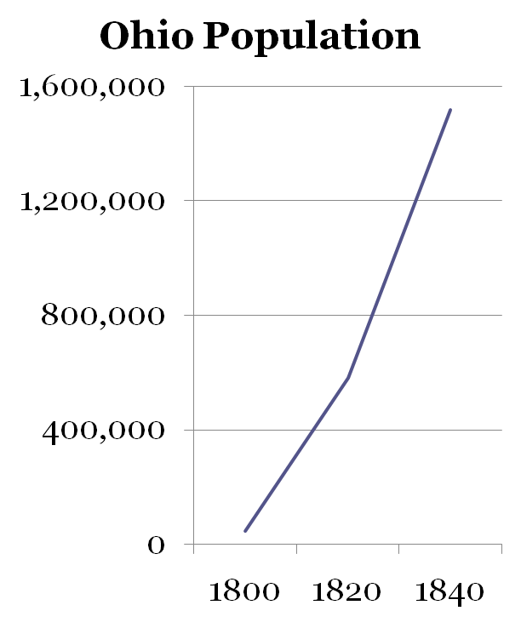
Section 1: Westward Expansion
From 1790-1840 the United States expanded dramatically
New states admitted 1791-1803 Vermont, Kentucky, Tennessee, and Ohio
New states admitted 1816-1821 Indiana, Mississippi, Illinois, Alabama, Maine, and Missouri

Slide 3
Expeditions into the West
Expeditions “whetted interest into the Far West”
  Lewis & Clark
  John Jacob Astor founds 1811 fur-trading post of Astoria
  1820s-1830s fur traders operate from Appalachians-Missouri River
Mountain Men, white fur trappers, gathered fur on their own while performing astounding feats of survival in harsh surroundings.
  Jedediah Smith, “representative of these men.”

Slide 4
Perceptions of the West
Pioneers saw west as area between Appalachians and the Mississippi
Even by 1840 few ventured into far west.
Newspapers, pamphlets, and letters depict west as being “harsh and risky.”
Missouri legislator writes, “there neither is, nor, in the nature of things, can there ever be, any thing like poverty there. All is ease, tranquility and comfort.”

Slide 5
Pioneer’s Quest for Stability
They migrated as families
Stayed close to navigable rivers of the West (Ohio and Mississippi River systems) until canals and railroads in 1820-1830
Clustered with people who came from the same region back east
Craved sociability… partook in sports and festivities
  Wrestling, lifting weights, pole jumping, modern hammer toss

Slide 6
Pioneer’s Quest for Stability
Men given heavy work
  Cut down trees
  Plowed fields
Women assigned chores
  Woke up earlier to milk cows, make breakfast
  Made clothes (before 1830s factory made clothing)
  Helped butcher dogs
  Fashioned coverlets that warmed beds

Slide 7
Broke Westerners
Before 1830 few westerners could afford good living.
Cow paths doing double duty
West only contains “sprinkling” of elegant mansions
Planters lived in rough conditions prior to 1830
Lack of refinement leads to East’s “contemptuous jibes”
… Insults exchanged

Slide 8
The Federal Gov. and the West
States already ceded their western land claims to the national government, good because it created a bountiful public domain
Ordinances of 1785, 1787 allow settlement and transformation of western territories into states.
Louisiana Purchase (1803) – brought in entire Mississippi River
Transcontinental Treaty of 1819 wipes out Spanish power east of Mississipi

Slide 9
Westward effects
Promised made to soldiers who enlist (during war of 1812) land after the war
6 million acres allotted to war vets
National Road construction began in 1811, further funding by congress in 1816.
America’s policies/expansion work to the disadvantages of Native Americans
“Native Americans the only real losers of the war of 1812”

Slide 10
The Five in-the-way tribes
Cherokees, Choctaws, Creeks, Chickasaws, and Seminoles
Came in sizable numbers
Mixed-bloods became influential minority
The tribes were viewed with contempt
Full-bloods prosecute mixed-bloods for “bartering away lands” to whites
“Indians” fall victim to removal legislation under Monroe, Adams, and Jackson

Slide 11
Further Native American tribulation
In 1830, Jackson passed the Indian Removal Act
  Authorized the exchange of public lands in the West for Indian territories in the East and appropriated $500,000 to cover expenses of removal
Cherokee Nation v. Georgia in 1831
  Cherokees proclaim themselves independent
  Status denied, protection from Georgia
  S.C. decision little impact
  Treaty of New Echota: cedes all Cherokee lands to U.S. for 5 mil and free passage to west.
  Cherokee party murders 3 principal signers – The Trail of Tears (p. 243)

Slide 12
Agricultural BOOM
Domestic and foreign demand for food stuffs intensifies, commodity prices rise between 1815 and 1819
American river systems convenient for shipping
“Alabama fever” grips southerners… pulls them into Old Southwest.
By 1820, Alabama and Mississippi produce half of the nation’s cotton
Cotton production triples
Value of cotton exports rose 300 percent

Slide 13
The Market Economy
Subsistence agriculture
The cash crop (i.e. wheat or cotton) that farmers grow to sell in other markets is
Commercial Agriculture or “the market economy”
High prices after war of 1812 encourage commercial agriculture
Forced famers into short-term debt in the hope of long-term profit

Slide 14
Federal Land Policy
Ordinance of 1785: divided public lands into townships of 6 miles each and then subdivided each township into one-mile-square lots of 640 acres.
Intended farmers to band together to purchase sections creating neighborhoods.
Federalists reluctant for settlement in West, eager to raise revenue
  Sold huge tracts of land to speculators who did not intend to farm
Federalists maintained the min. purchase at 640 acres, $2/acre, 1 year for complete payment

Slide 15
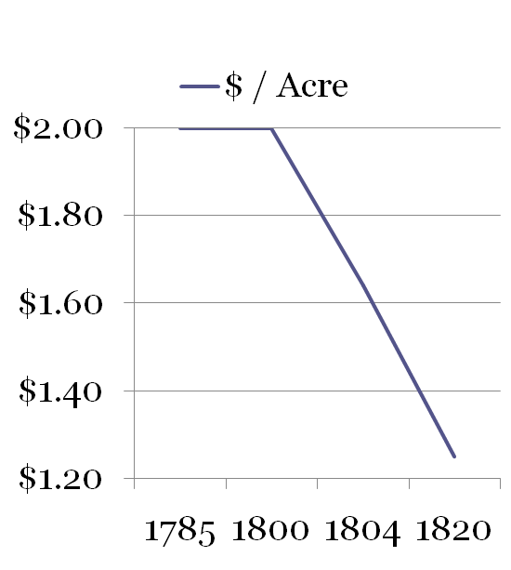
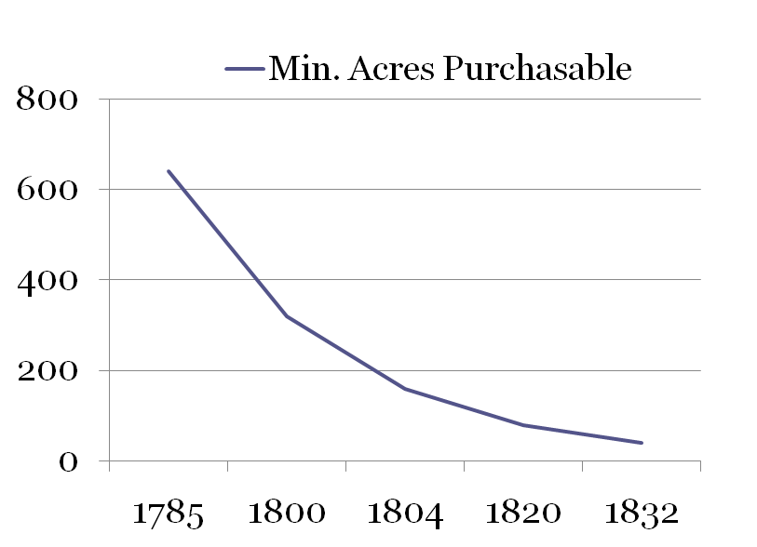
TJ & Republicans
Land Law of 1800 drops min. purchase rates, further decreases …

Slide 16
Banks
Second Bank of the United States chartered in 1816
Stimulated the chartering of private banks, or state banks
Circulation grows from $45 mil in 1812 - $100 mil in 1817
1819 sales of public land were over 1,000 percent > average in 1800-1814

Slide 17
The Speculator and the Squatter
Squatters are a familiar frontier type who were independent settlers
Pressured Congress to allow preemption rights-
  The right to purchase at the min. price land that they had already settled on
Congress passed special preemption laws
Farmers had to buy land from speculators on credit at vicoius credit interest rates
Sought to the market economy

Slide 18
The Panic of 1819
State banks long emitted far more bank notes than they could redeem (or pay back)
  Bank notes (pieces of paper with printed promises) served as money
Bearer of a bank note may retrieve certain amount of specie, or gold or silver coinage
Farmers borrowed too much money in hopes to repay by selling crops…
But foreign demand decreased, farmers too dependant on agriculture

Slide 19
The Panic of 1819
State banks had to force farmers and land speculators to repay loans
Speculators lose value in bought land
Land prices fell ($69/acre - $2/acre)
Cotton prices fell (32 cents / lb in 1818– 17 cents /lb in 1820)

Slide 20
Panic Leaves Distaste
People grew skeptic about banks, particularly the Bank of the United States
The panic displayed America’s vulnerability to foreign competition
Demands made for protection of domestic industries
Farmers grew too dependant on distant markets
Fall in cash crop prices leads to search for better forms of transporting

Slide 21
The Transportation Revolution
1807, Robert R. Livingston and Robert Fulton introduced the steamboat Clermont on the Hudson River.
They gained a monopoly from the New York legislature to run a ferry service
Profits lured competitors against their monolopy
Competitors file suit against Livingston-Fulton…

Slide 22
Gibbons v. Ogden
Supreme Court decides against the monopoly in 1824
Unanimous decision, C.J. Marshall rules that Congress’s power to regulate prevails over New York’s power to license the monopoly
After this steamboat traffic increased rapidly
Steamboats operating goes from 17 in 1817 - 727 in 1855

Slide 23
Transportation Acceleration
Steamboats offered practical means of faster travel, in more ranges of weather, and provided spacious luxurious cabins
Canals offer prospect of connecting Mississippi-Ohio River system/Great Lakes/East Market (but were expensive)
The Erie Canal started a canal boom late 1820s-1830s
Ohio constructed network of canals to Lake Erie
Canals reduce shipping costs from 20-30 cents ton/mile in 1815 to just 2-3 cents ton/mile by 1830

Slide 24
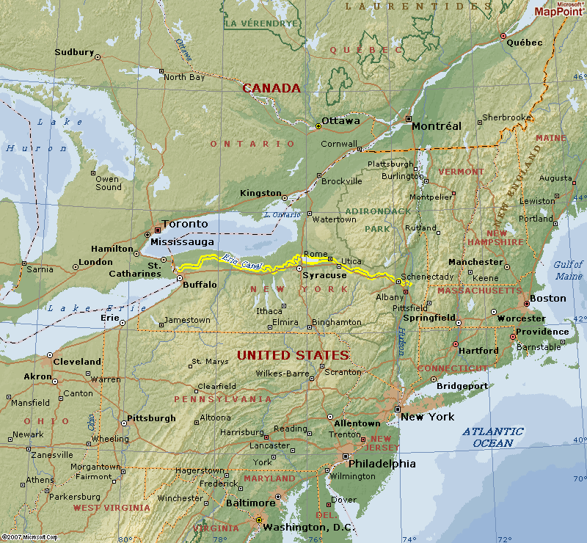
The Erie Canal
Erie Canal ships milled wheat to Albany
then down to Hudson River

Slide 25
Transportation Acceleration
1815, world’s first railroad devoted to general transportation begins operating in England
By 1840 some 3,000 miles of track laid in America
Investment in American railroads exceeds canals in 1830s
Railroads easy alternative to canals
Cheaper, faster, more convenient
In 1849 railroad freight revenues exceed passenger revenues

Slide 26
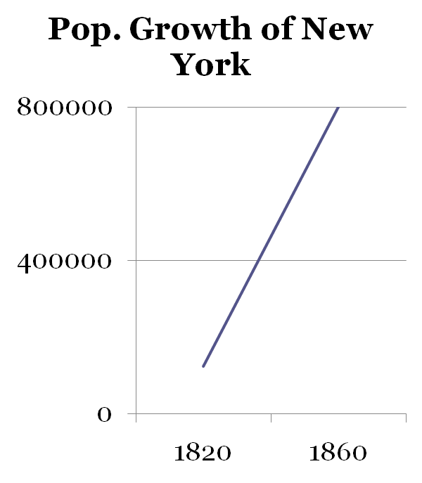
Growth of Cities and Communities
Transportation revolution accelerates growth of towns and cities
Other towns also saw
rapid growth
1820-1860 was America’s
most rapid period of urban-
ization

Slide 27
Section 2: The Rise of Manufacturing
Manufacturing literally means “making by hand”
Industrialization is when machines make items at mass production in a factory
Between 1915 and 1860 there was a big rise in manufacturing, especially in the production of cotton textiles and shoes

Slide 28
Causes of Industrialization
With the help of the transportation revolution, farmers could concentrate on farming and buying manufactured clothes and shoes
Britain’s industrialization was a generation ahead of America
  English immigrants would teach eager Americans the “mystery” behind textile production in England.
Americans took the next step in making inventions also
  Oliver Evans of Delaware built an automated flour mill requiring only one supervisor
  Eli Whitney invented the cotton gin, and in 1798 he used unskilled workers to make identical interchangeable parts for muskets

Slide 29
Causes of Industrialization
The idea for interchangeable parts originated in Europe, but the US led all nations in applying the idea in factories-
so much so that it came to be called the American system of manufacturing
As late as 1860, the average manufacturing establishment contained only 8 workers.
Outside of textiles, many industries continued to depend on industrial outwork.
Putting-out system: outworking, central agent subcontracts people to work in their respective facilities (usually homes)

Slide 30
The Faces of Industrialization
1813: Boston Manufacturing Company was funded by Boston Associates
  Ten times the capital of a typical mill
1836: controlled eight companies with over 6,000 employees
Waltham and Lowell Mills: Massachusetts, started by Boston associates, first to concentrate on total cloth production in the factory
80% of workers were young unmarried women who lived in company housing- these women staged 2 of the largest strikes in American history to that date

Slide 31
The Faces of Industrialization
Because of the rise of Industrialization many artisans lost their jobs
They began to from trade unions and “workingmen’s political parties
With lower wages and deterioration of working conditions, unskilled workers were also upset
Let to the United States’ first general strike

Slide 32
Section 3: Equality and Inequality
Growing inequality: The Rich and the Poor
The gap between the Rich and the poor was widening during the nineteenth century
New York City- Richest 4% owned nearly half the wealth in 1828 and more than 2/3 by 1845
Boston – 1848 = 8% of Boston’s population owned only 4% of it’s wealth
“Rags to Riches” didn’t happen much
Wealth were wealthy all there life

Slide 33
Free Blacks in the North
Blacks were restricted from voting
Even freed slaves
Excluded from major cities, facilities, public schools, and other buildings

Slide 34
The “Middling Classes”
Americans used the term as the middling class began to appear during 1800-1860
Was made up of farmers and artisans
Self-Employment
The commercial industry economy of antebellum America helped Americans reach success, though not everyone reached success

Slide 35
Section 4: Social Relationships
Nation sought for new authorities
Claims to social superiority was heavily questioned
Lawyers, physicians, and ministers were criticized
Revivalists blasted the clergy for creating complicated theologies
“The Second Great Awakening” between 1800 and 1840

Slide 36
Attack on the Professions
Medicine movement lead by Samuel Thomson to eliminate barriers for medical professions
Market economy demanded more lawyers and physicians
Ministers became more ambitious to leave small and poor congregations for larger and wealthier ones
Lawyers and doctors were transients without deep roots

Slide 37
The Challenge to Family Authority
Economic changed forced young people to choose between staying at home or venturing on their own
Young men desired independence to leave home earlier and strike out on their own
Young people desired romantic marriages, not arranged marriages
The Young Man’s Guide by William Alcott encouraged young people to live lives of “character”

Slide 38
Wives, Husbands
Advice books were written that counseled wives and husbands on their rights and duties
Spouses began to form equality between each other – 1820s and 1830s.
Separate spheres:
Men: made the money and governed the world.
Women: gave moral influence on family and gained new power within their families.

Slide 39
Wives, Husbands
Letters to Mothers by Lydia Sigourney – advice book to mothers on how to discipline.
Andrew Jackson Downing hoped to offset the “spirit of unrest” and the American feverish pace; led to fleeing of cities in 20th century.
“Home Sweet Home”- the ideal home / plans for peaceful single-family homes.

Slide 40
Wives, Husbands
Birthrates declined and women began to control number of children to bear: 1800-7.04, 1850-5.02, 1900-3.98
Birth-control methods were established in 1865
Economic and ideological considerations began to blend together.
Husbands noted economic value of children was declining; wives carried out domestic duties and could nurture children

Slide 41
Horizontal Allegiances and the Rise of Voluntary Associations
Forms of authority began to weaken; people began to prefer horizontal allegiances rather than vertical allegiances.
Unions were formed: wives, young men, characteristics, experiences, interests, gender, and race
Voluntary associations formed in the 1820s and 1830s to encourage sociability and members could influence forms of authority when they were weakening

Slide 42
Focus Questions:
What caused the upsurge of westward migration after the War of 1812?

Slide 43
How did the rise in the prices of farm commodities after 1815 relate to the growth of banks, and how did the spread of banks relate to the Panic of 1819?

Slide 44
How do you account for the vast public investment in canals during this era, and how did the rise of canals and railroads affect where Americans lived and how they made their living?

Slide 45
How did the combined effects of the transportation revolution and the rise of industry influence relationships within families and communities?

Slide 46
Who were the winners and the losers in this period of swift change?

Slide 47
MCQ’S

